Slide 1
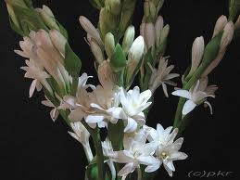

Slide 2


Slide 3
Presented by :
Apu Chandra Das
Lecturer in English
Khidirpur College
Monohardi,Narsingdi

Slide 4
English For Today
Unit_ six; Lesson_two
Class _Eleven

Slide 5
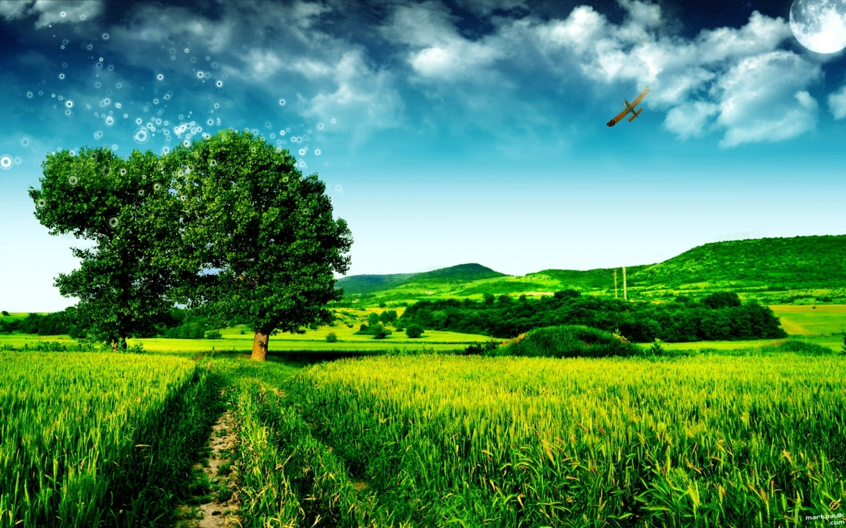
Green field with trees and hills

Slide 6
River

Slide 7
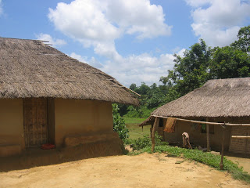
Rural houses of Bangladesh

Slide 8
This is our Environment

Slide 9
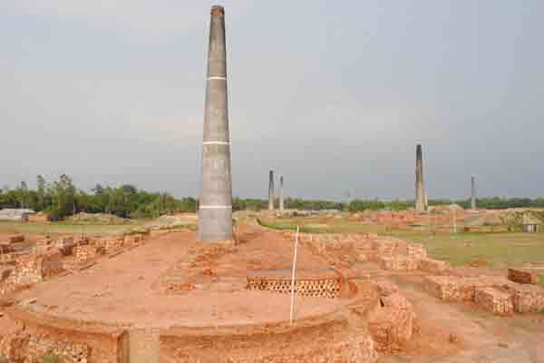
Brickfield; it is polluting the air

Slide 10
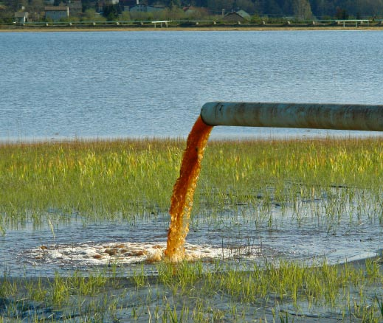
Disposal of industrial waste and polluting water

Slide 11
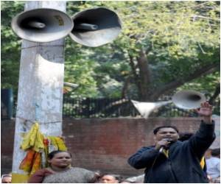
Sound from mike is an element of sound pollution

Slide 12
So our todays lesson is about Environment Pollution

Slide 13
At the end of the study students will be able to:
read the passage about environment after listening from the teacher
tell about the pollutants of the environment
write the effect of environment pollution on us
enrich their vocabulary with new words

Slide 14
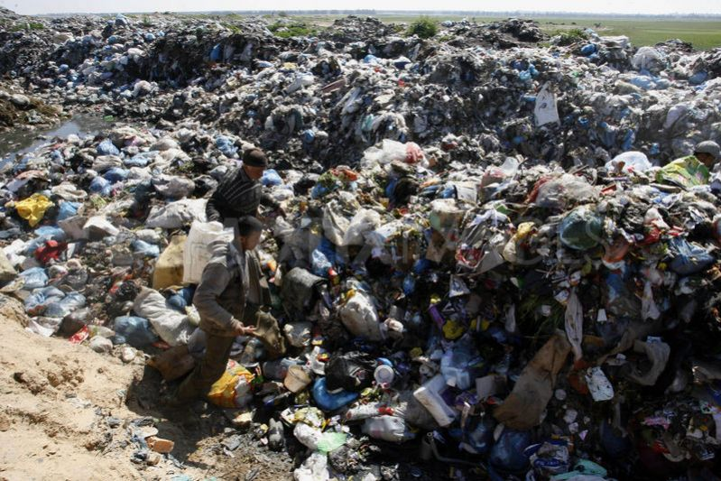
Rubbish
= dirt, waste
Don’t throw domestic rubbish here and there.

Slide 15
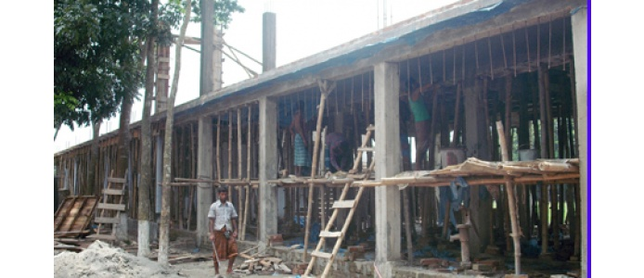
Construction of a building
Construct=build,make
The construction work of the building is stopped.

Slide 16
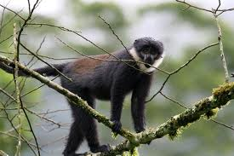
Langure on the tree
Suitable=appropriate,perfect
Everyone requires a suitable place to live

Slide 17
Now read out the passage and find out other pollutants of the environment.

Slide 18
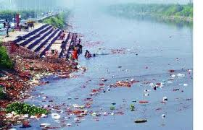
People pollute water throwing various waste

Slide 19
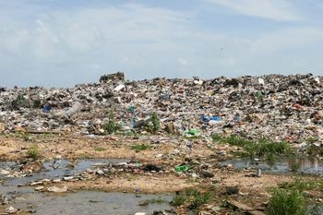
Soil is being polluted by throwing garbage and disposing polluted watar

Slide 20
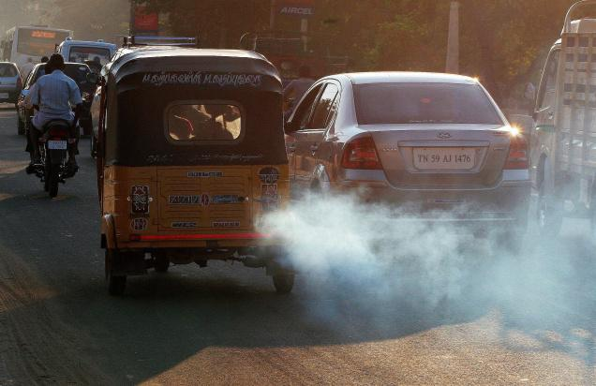
What are the signs of environmental pollution as shown in the picture and how? Write down these in groups.

Slide 21
Fill in the blanks with suitable words from the box.
*** The------------- of various kinds of waste is ----------- polluting the environment.
*** We know that air is an ------------- element of our environment.
*** Man pollutes water by ----------- waste into it.
*** -------------- of forests is also responsible to environment pollution.
disposal
seriously
throwing
Destruction
important

Slide 22
Home work
Write a paragraph on Environmental Pollution

Slide 23
Thank You All

Slide 24


Slide 25
Here are some pictures which pollute the environment.

